Slide 1
Dual steganography for hiding text in video using linked list method
JYOTHIKA UDUGULA

Slide 2
INTRODUCTION
In the present era, Security of information is one of the most important factors of information technology and communication. Every person wants their communicating data to be secret and safe. Any organization who deals with confidential data whose first priority is sending the safe and secure messages to other. Almost all information hiding techniques are used for military, internet banking, intelligence agencies and for privacy etc. so it is most important topic in the current time.
The two important techniques for providing security are cryptography and steganography. Both are well-known and widely used techniques which used for information security for confidentiality of data exchange.

Slide 3
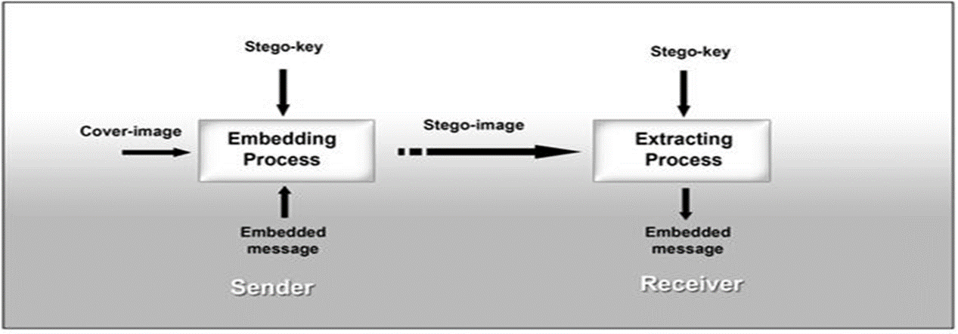
Steganography
Steganography is the practice of concealing a file, message, image, or video within another file, message, image, or video.
Cryptography
Cryptography is a branch of mathematics concerned with the study of hiding and revealing information and also for proving authorship of messages.
DUAL STEGANOGRAPHY
Inside the steganography process, cryptography is used, so it’s called as Dual Steganography. The basic model of dual steganography is the secret data is firstly converted into encrypted form and then using this encrypted information as secret data, is hidden inside the cover image with the help of embedding algorithm and finally the stego image is formed which is same as cover image in human perceptible way.

Slide 4
ABSTRACT
EXISTING SYSTEM:
Video Steganography may be a technique to cover any reasonably files into a carrying video file. The employment of the video primarily based steganography is additional eligible than different transmission files thanks to its size and memory necessities. The average number of still images per unit of time of video is twenty four frames per second.
If a person sends sensitive information over the insecure channels of the system then there may be a chance of hacking it, they can alter the information and sends it over the net. (Example is military persons sending sensitive information over the net.)

Slide 5
PROPOSED SYSTEM:
In the proposed system the above problem has been solved by encrypting before embedding the data into the video file. Then this video file will be passed over the net, even if hacker hacks it, can be able to see only an video file. At the destination side this data will be encrypted from video file and performs decryption to get original message.
By using this concept:
Large amount of data can be stored because of embedding the information inside video.
More security will be provided to data since the information is encrypted using Feistel network before embedding it inside the video.
Quality of cover video will not be affected.
Since Linked List method has been used for embedding information inside video, it will be difficult for the intruders to predict the location of the presence of the information inside each frame. In Linked List method, after embedding the byte of information inside one 3*3 pixel, the address of the location of next byte of information should be embedded next to it. The Stego frames are then combined to get the Stego Video.

Slide 6
H/W System Configuration:-
Processor - Pentium –III
Speed - 1.1 Ghz
RAM - 256 MB(min)
Hard Disk - 20 GB
Floppy Drive - 1.44 MB
Key Board - Standard Windows Keyboard
Mouse - Two or Three Button Mouse
Monitor - SVGA
S/W System Configuration:-
Operating System :Windows95/98/2000/XP
Front End : java, jdk1.6
Database : My sqlserver 2005
Database Connectivity : JDBC.

Slide 7
Modules
There are two modules in this project of dual steganography
Client(sender)
Server(receiver)
Client :
the one who encrypts the data using the key and embed in video and send it to the receiver
Server:
the one who receives the data and knows the key used by the client, decrypts the data into readable form

Slide 8
Diagrams:
use case diagram for Dual Steganography for hiding text in video

Slide 9
class diagram for Dual Steganography

Slide 10
implementation
The Implementation of hiding text in the video by Dual Steganography is done by running the code of the java in which we develop a software for dividing video into Frames and embeding data
After the execution of the code we will be directed to the software we developed
We need to select the embeded message and choose a video for input and the output master file and Go..
Next, we need to select encrypt and set password of minimum 8 characters which is known to the receiver and enter the secret message .
Now, you can send the video to your receiver which contains the message in it
The receiver on receiving the video runs the software and clicks retrieve message and give the password
Then the secret message will be displayed on the screen.

Slide 11
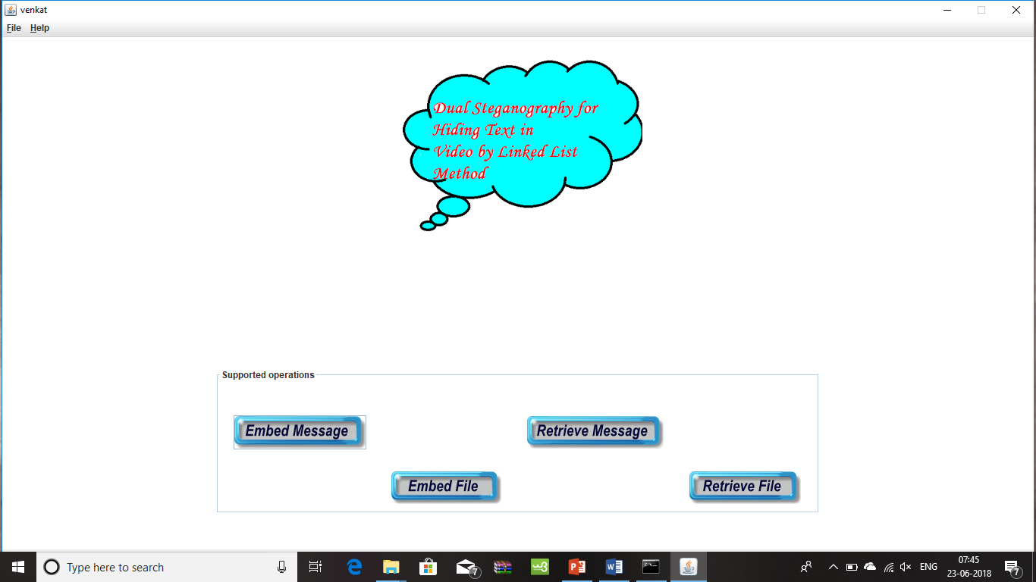
Screenshots
the software that developed for dual Steganography

Slide 12
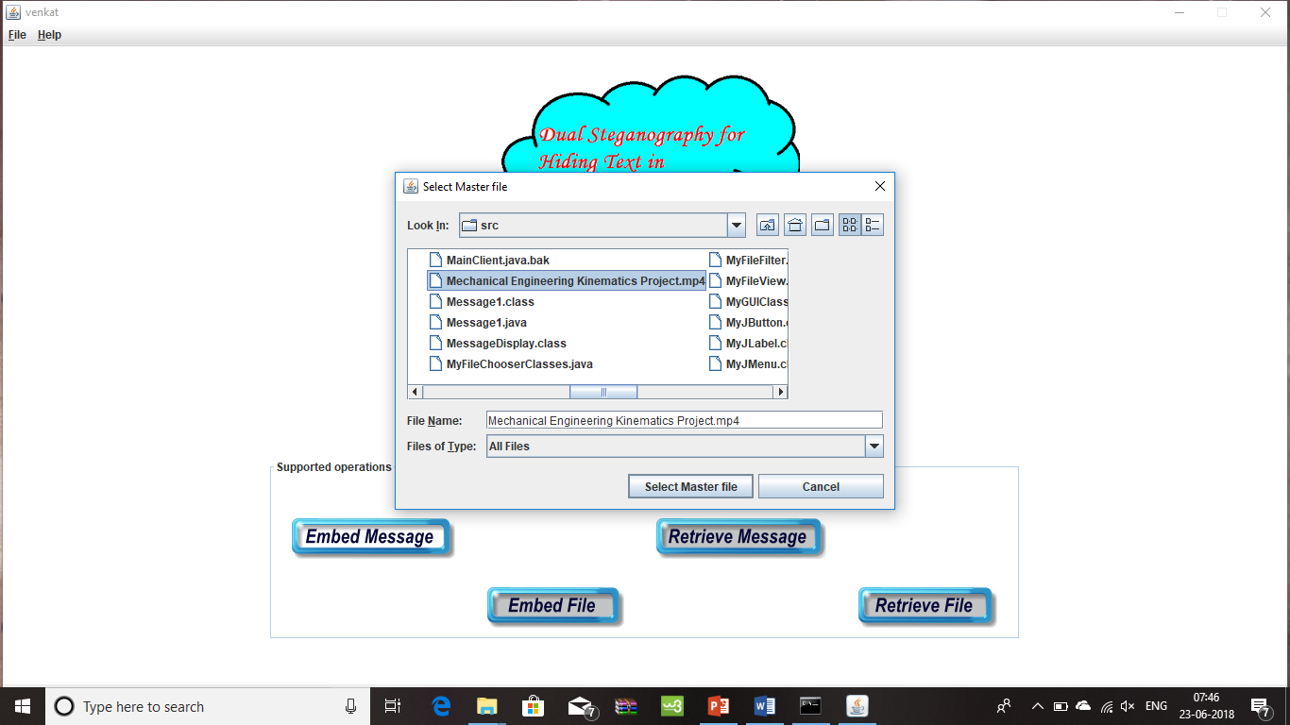
Selecting a video as Master File

Slide 13
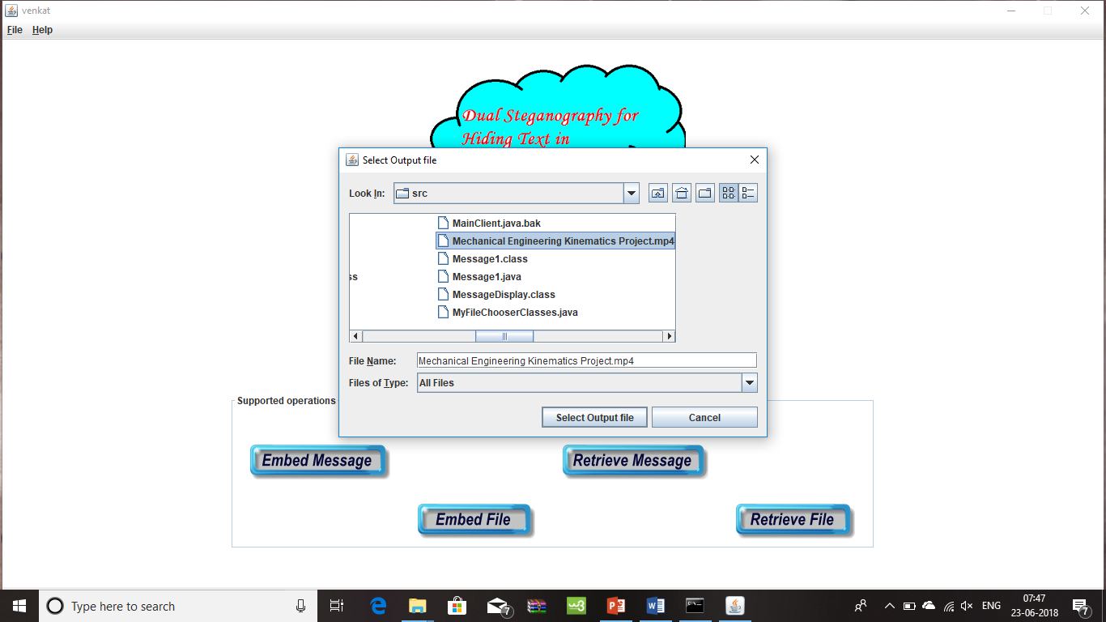
Selecting an Output File

Slide 14
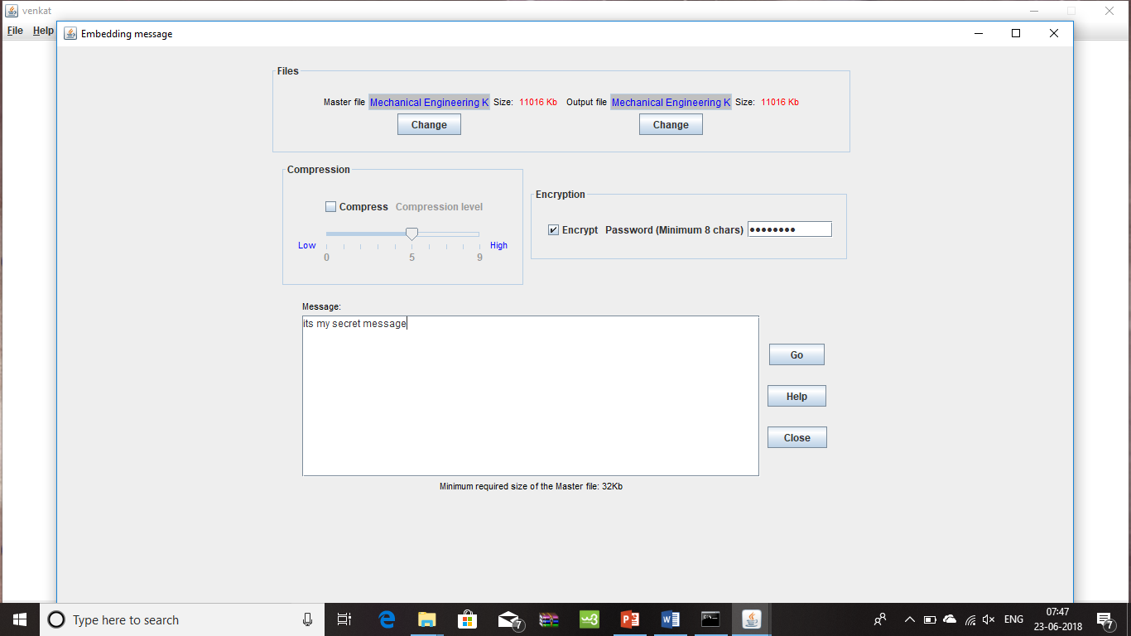
encrypting the message with password and setting the message

Slide 15
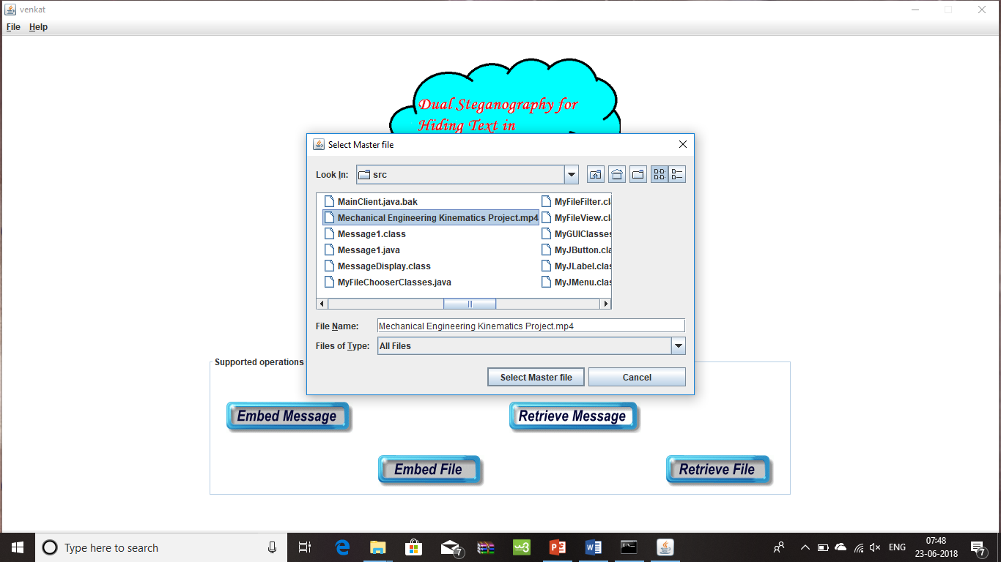
The receiver retrieve message and select the Master File

Slide 16
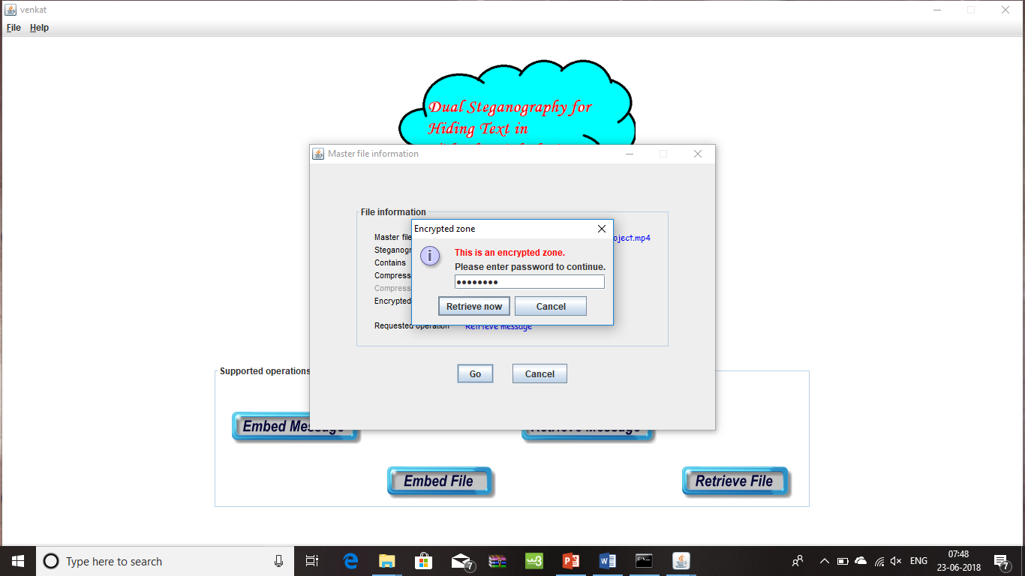
Enter the Password and retrieve now

Slide 17
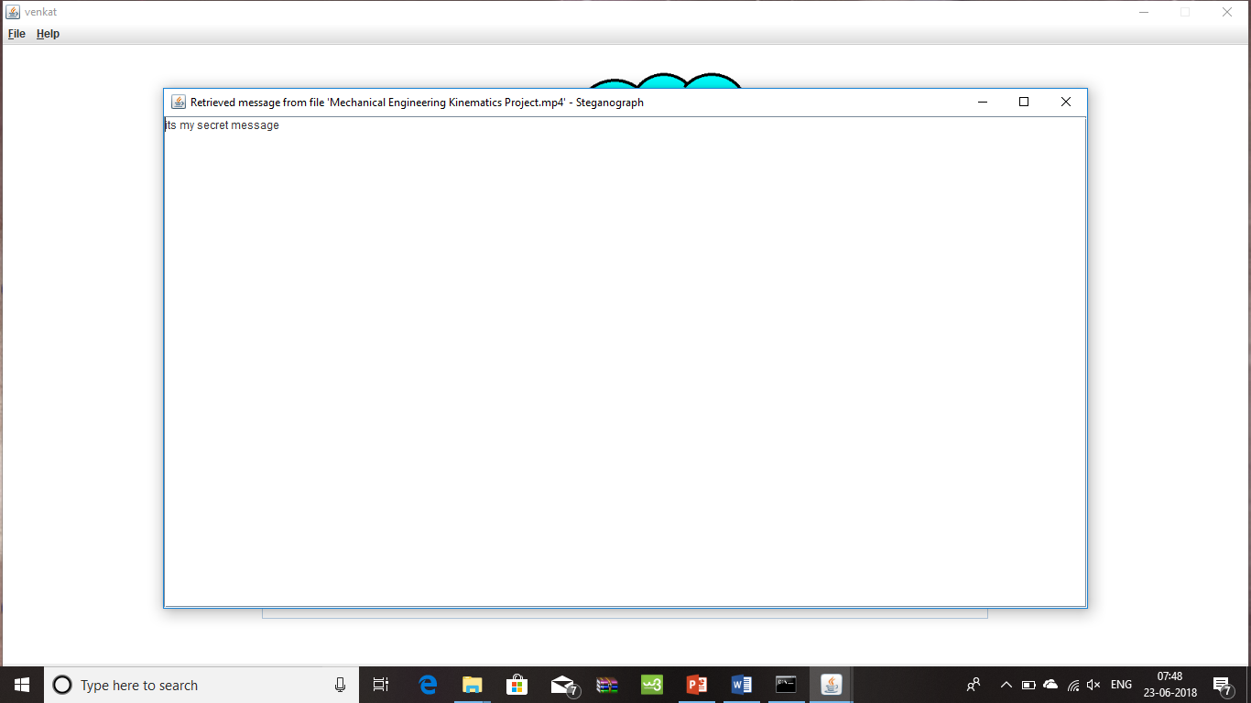
The message is displayed to the receiver

Slide 18
CONCLUSIONS
Due to increasing demand for privacy and security, a need for various data hiding techniques which lead to the development of several techniques for embedding and extraction. As we know, cryptography and steganography have been known for many years. We can encrypt data, but it will be exposed while transferring. On the other hand, we can hide data into a common object, but if someone extracts it, he/ she can get the information easily. Therefore if we combine both of them, so in case one gets the embedded stuff, she/he will face an encrypted data.

Slide 19


